Slide 1
Comp Sci 310
Day 34

Slide 2
Announcements
Assignment 5 posted by tonight
Assignment 5 due Wednesday, 12/3
Partner(s) / self assessment component (online form)
Quiz 13: Friday, 11/21
Pipeline micro-architecture
Quiz 14(last quiz): 12/3 or 12/5
Wrap-up / review: 12/8
Exam 3(part 1): 12/10
Old stuff
Exam 3(part 2): 12/12
New stuff

Slide 3
Instruction-level parallelism
Note that pipelining is a form of instruction-level parallelism (ILP)
What about a programmer using a sequential programming model?
Pipelining is invisible to the programmer

Slide 4
Performance discussion
Which one(s) is(are) correct?
Allowing jumps, branches and ALU instructions to take fewer stages than the five required by the load instruction will increase pipeline performance under all circumstances.
Trying to allow some instructions to take fewer cycles does not help, since the throughput is determined by the clock cycle; the number of pipe stages per instruction affects instruction execution latency, not throughput.
Instead of trying to make instructions take fewer cycles, we should explore making the pipeline longer, so that instructions take more cycles, but the cycles are shorter. This could improve performance.

Slide 5
SINGLEcycle Larc CPU
00..01
JAL
ADD
0
LW
0
1
1
0
ADD
1
LIMM
SIGN EXTEND
[4..11]
RFWRITE
SW
MEMWRITE
IM
RF
RD1
DM
RB[4..7]
BE
RR1
0..0
0
BN
RC[0..3]
RR2
RD1
1
PC
z
RA[8..11]
WR
ALU
ALU
RD
address
address
RFWD
RD2
0
<< 8
2
instruction
0
1
NOR
LIMM
SIGN EXTEND
1
WD
SUB
WD
[0..7]
2
SE
3
SIMM[8..11]
0
SIGN EXTEND
SIMM[0..3]
1
CONTROL UNIT
OPCODE[12..15]

Slide 6
Pipelined execution
Time
CC1
CC2
CC3
CC4
CC5
CC6
CC7
Program execution order
ALU
I M
R F
D M
R F
LW R3 0(R1)
ALU
I M
R F
D M
R F
ADD R4 R1 R2
ALU
I M
R F
D M
R F
SW 0(R2) R5

Slide 7
How many pipelines?
How many separate pipelines do we need for our Larc implementation?
Just have one for each instruction
TOO MANY!
_____ separate pipelines can accommodate any number of instructions

Slide 8
How many pipelines?
How many separate pipelines do we need for our Larc implementation?
Just have one for each instruction
TOO MANY!
FIVE separate pipelines can accommodate any number of instructions
Why?

Slide 9
Fewer separate pipelines?
Five separate pipelines suffice for our Larc implementation
Can we do better than having five separate implementations of the pipeline?
We can get away with one pipeline…
…assuming what is true?

Slide 10
Laundry example revisited
Think back to the laundry example
Going from one stage to the next, what extra “thing” do you need to help you?
What if the washer is far away from the dryer, the dryer is far away from the folding table and the folding table is far away from the dresser?
Is one extra basket enough?
How many do you need?

Slide 11
Pipeline stages in the Larc CPU
IF
ID
EX
MEM
WB
00..01
JAL
ADD
0
LW
0
1
1
0
ADD
1
LIMM
SIGN EXTEND
[4..11]
RFWRITE
SW
MEMWRITE
IM
RF
RD1
DM
RB[4..7]
BE
RR1
0..0
0
BN
RC[0..3]
RR2
RD1
1
PC
z
RA[8..11]
WR
ALU
ALU
RD
address
address
RFWD
RD2
0
<< 8
2
instruction
0
1
NOR
LIMM
SIGN EXTEND
1
WD
SUB
WD
[0..7]
2
SE
3
SIMM[8..11]
0
SIGN EXTEND
SIMM[0..3]
1
CONTROL UNIT
OPCODE[12..15]

Slide 12
Pipeline buffers in the Larc CPU
IF/ID
ID/EX
EX/MEM
MEM/WB
00..01
JAL
ADD
0
LW
0
1
1
0
ADD
1
LIMM
SIGN EXTEND
[4..11]
RFWRITE
SW
MEMWRITE
IM
RF
RD1
DM
RB[4..7]
BE
RR1
0..0
0
BN
RC[0..3]
RR2
RD1
1
PC
z
RA[8..11]
WR
ALU
ALU
RD
address
address
RFWD
RD2
0
<< 8
2
0
1
NOR
LIMM
SIGN EXTEND
1
WD
SUB
WD
[0..7]
2
SE
3
SIMM[8..11]
0
SIGN EXTEND
SIMM[0..3]
1
CONTROL UNIT
OPCODE[12..15]

Slide 13
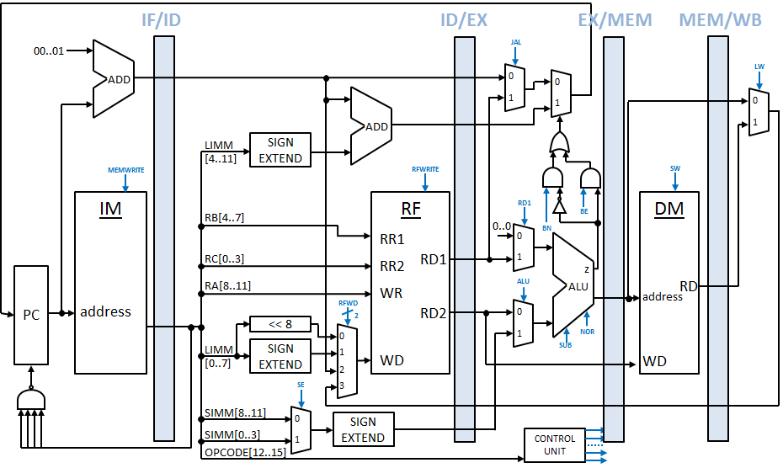
Pipeline buffers
Main difference between single-cycle and pipeline datapath…
Need for pipeline buffers between pipeline stages
Why is there no buffer after the WB stage?
What is the difference between the PC and the blue buffers (groups of registers)?

Slide 14
Pipeline hazards
There are situations in pipelining when the next instruction cannot execute in the following clock cycle
These events are called hazards
Three different types:
Structural
Data
Control

Slide 15
Pipeline hazards
There are situations in pipelining when the next instruction cannot execute in the following clock cycle
These events are called hazards
Three different types:
Structural
Data
Control

Slide 16
Structural hazards
Structural hazard: hardware cannot support the combination of instructions that we want to execute in the same clock cycle
Many instruction sets are designed to be pipelined
E.g., Larc
Human / laundry analogies?
Notes:
Laundry:

Slide 17
Example
Suppose our micro-architecture had one memory
Data and instructions
Imagine four (LW) instructions in the pipeline
What happens?
The first instruction is reading data from memory at the same time…
…the fourth instruction is fetching the instruction from memory

Slide 18
Structural hazard example
Time
CC1
CC2
CC3
CC4
CC5
CC6
CC7
Program execution order
ALU
M
R F
M
R F
ALU
M
R F
M
R F
ALU
M
R F
M
R F
ALU
M
R F
M
R F

